Slide 1



Usages of research methods in Social Work field Ethnography, Social Survey, Experimental and Case Study
Presented by
Farjana Akter
SO-05 (04)
Smart Office Management
Notes:
NOTE:
To change the image on this slide, select the picture and delete it. Then click the Pictures icon in the placeholder to insert your own image.

Slide 2

Curious Human Mind
!
Tendency to explore unknown
Use arbitrary method
Right or wrong decisions
Move into scientific method

Slide 3
Research Methods
Numerous methods of research
Narrative
Phenomenological
Grounded Theory
Ethnography
Case Studies
Content Analysis
Survey Research
Descriptive Research
Experimental Research
Correlational Research
Causal-Comparative

Slide 4
Ethnography
Experimental
Some common methods
Social Survey
Case Study
Reason to use those methods
Those method have ability to explore complex social phenomenon. Ethnography explores cultural nuance, case study offers in-depth analysis, excremental research seeks for cause effect relationship, social survey covers large population and generalization.

Slide 5
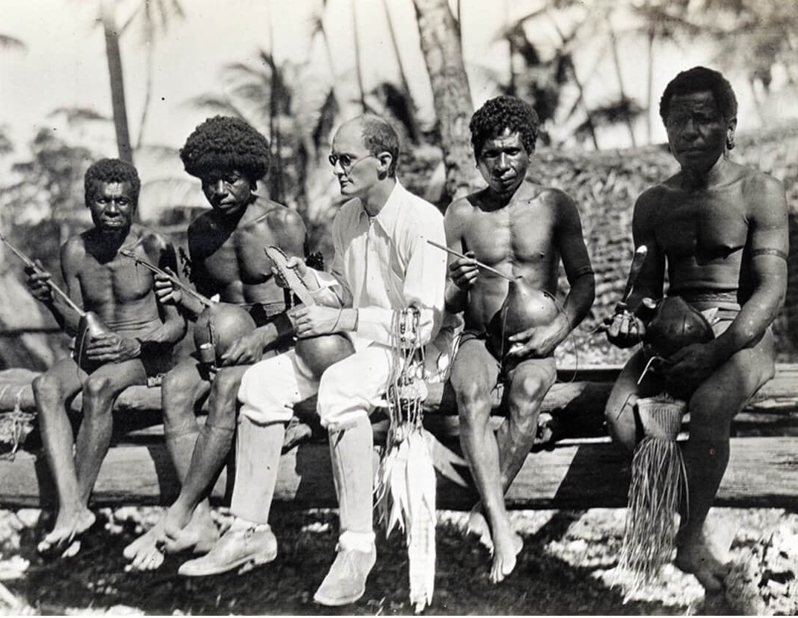
Ethnography Method
Fetterman noted that ethnographic research emphasizes in-depth comprehension of the phenomena which requires data collection from multiple sources including document analysis, participant observation, interviews, and cultural immersion by a researcher. It is a method that helps a researcher to explore the pattern of human experience through participation and careful observation of life events and culture of those under study. (Fetterman, 2010)

Slide 6
Examples of Ethnography Method in Social Work Research
Ferguson (2014)Researching Social Work Practice Close Up: Using Ethnographic and Mobile Methods to Understand Encounters between Social Workers;
The study uses ethnographic and mobile methods to study social work during home visits for child protection, focusing on interactions between social workers and service users. The research highlights sensitive moments involving children in domestic settings and provides ethical insights to improve social work practices and prevent stop of service when child deaths.
Haight et al. (2014) Ethnography in social work practice and policy. Qualitative Social Work;
The study explore the use of ethnography in social work with vulnerable, marginalized, or stigmatized groups. Their studies highlight the challenges and opportunities of ethnography, including the need for culturally sensitive interventions, blending insider and outsider perspectives in international contexts, and addressing ethical concerns when working with stigmatized individuals.

Slide 7
Advantages
In-depth understanding
Flexibility
Naturalistic setting
Holistic approach
Access to vulnerable community
Limitations
Difficulty in Structured Observation
Reactivity
Time-Consuming
Researcher Bias
Privacy and ethical risks

Slide 8

Experimental Method
The experimental design is the most scientifically sophisticated design that can be ideally defined as the “observation under controlled conditions” (Thyer, 2012).
Experimental method is a scientific approach used to explore cause-and-effect relationships by manipulating one or more variables and observing the outcomes.

Slide 9
Examples of Experimental Method in Social Work Research
Margaret Shaw (1974) Social Work in Prison: An Experiment in the Use of Extended Contact with Offenders; The study investigated the impact of intensified pre-release counseling for prisoners at Gartree (maximum-security) and Ashwell (open prison). Counseling was provided to randomly selected inmates, with control groups not matched. The study found that introverted prisoners in the experimental group showed significantly better outcomes, highlighting the role of personality traits like introversion in rehabilitation efforts.

Slide 10
Advantages
Control Over Variables Establishing Cause-and-Effect Relationships Reproducibility Precision and Objectivity Innovative Insights
Limitations
Artificiality Cost and Time-Intensive Ethical Concerns Limited Scope Sampling Issues

Slide 11

Case Study Method
A case study is an in-depth research method used to study a person, group, event, process, or other social units, providing a comprehensive understanding of complex issues. It is especially useful for exploring real-world phenomena in their natural context and allows researchers to gain deeper insights that may not be captured by other methods.
Stoecker, 1991 defines, "A case study is an intensive research in which interpretations are given based on observable concrete interconnections between actual properties and people within an actual concrete setting."

Slide 12
Examples of Case Study Method in Social Work Research
Yin (2018) The Role of Family Support in the Recovery Process of Individuals with Mental Health Disorder; Researcher conducted a case study on a 32-year-old woman with bipolar disorder, highlighting the positive impact of family support on her recovery after transitioning to community care. Active family involvement, emotional support, and participation in therapy improved treatment adherence. The study stresses the importance of family dynamics in mental health recovery and recommends incorporating family-centered approaches in social work interventions.
Hossain A (2016) Affecting the Reduction of Domestic Violence against Married Women by Their Intimate Partners in Rural Bangladesh; The study used case study methods to explore the impact of domestic violence on women in rural Bangladesh. The study highlighted various forms of violence against women, including acid throwing, dowry deaths, and custodial violence, and examined the factors affecting the reduction of domestic violence by intimate partners.

Slide 13
Advantages
In-depth understanding Real-world context Holistic perspective Flexibility Theory building Rich qualitative data
Limitations
Time consuming Ethical concerns Limited generalizability Subjectivity & bias

Slide 14

Social Survey Method
The social survey method is a mainstay of social science research. It involves systematically collecting information from a specific group of people through questionnaires or interviews.
"A research method that involves asking a large number of people questions about their attitudes, behaviors, or characteristics in a structured way, typically through questionnaires or interviews" (Cohen, Manion, & Morrison, 2011).

Slide 15
Examples of Social Survey Method in Social Work Research
Veisani, Jalilian, and Mohamadian (2020) Relationship between internet addiction and mental health in adolescents;
A cross-sectional study in Lam City explored the relationship between internet addiction and mental health among adolescents, involving 362 participants. Using questionnaires, the study found that excessive internet use, lack of control, and neglect of social life were significantly linked to mental health issues in adolescents.

Slide 16
Advantages
Faster data collection Large sample Anonymity Generalization Modes
Limitations
Fails to capture depth of experiences Time consuming to analyze data (Open ended question) Relies on honesty and memory of the respondents Not useful for studying complex phenomena

Slide 17
Conclusion
The paper examines common research methods in social work and the challenges they present, including time and resource demands in ethnography, cost and ethical concerns in experimental methods, respondent bias and sampling issues in social surveys, and limited generalization and subjectivity in case studies. Researchers often use mixed methods to address these complexities.

Slide 18


